Slide 1
Adventures of Misguided Real Estate Listing Photographers
When the listing photo needs more help than the house & the image processing techniques to rescue them
Presented by Nichelle Graf

Slide 2
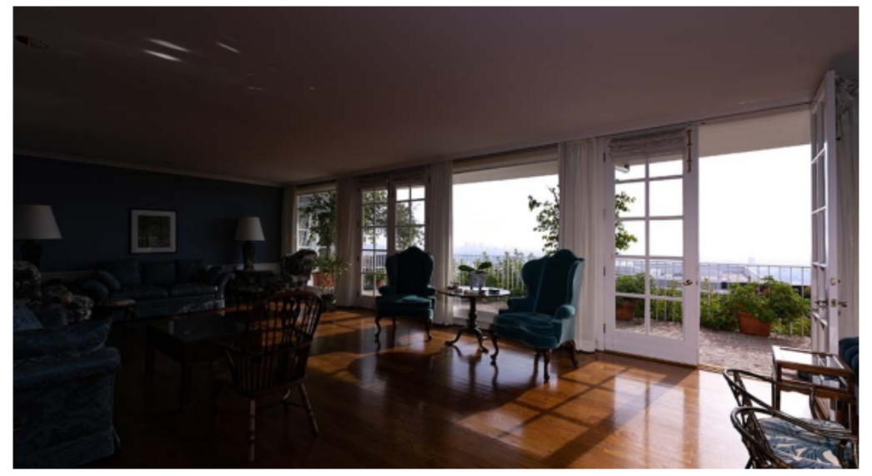
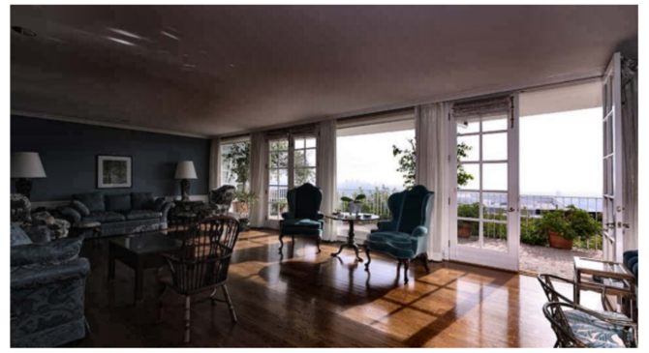
Episode 1:
The Cave With a View
Featuring: Dark interior → CLAHE
Can we actually see the room without sacrificing the million-dollar view?
Original
Enhanced

Slide 3

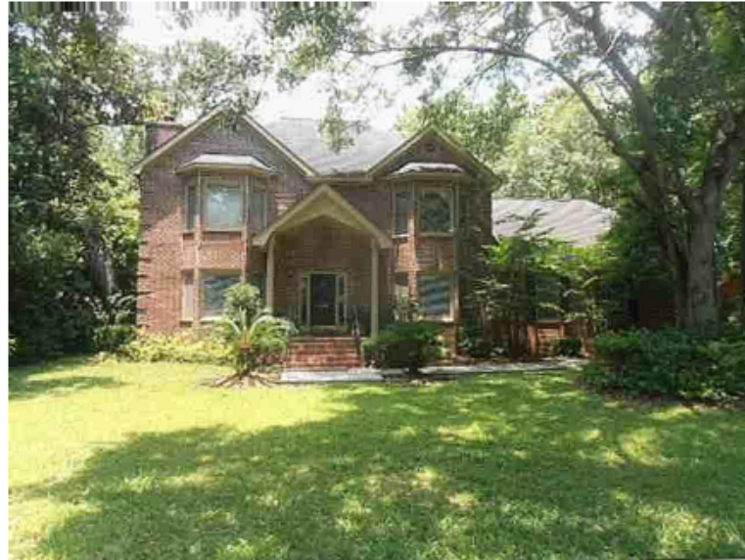

Episode 2:
The House Seen Through Vaseline
Featuring: Soft exterior → sharpening + straightening + crop
When curb appeal exists, but the photographer doesn’t want you to see it
Original
Enhanced

Slide 4


Episode 3:
Attack of the Electric Blue Sky
Featuring: Overprocessed luxury exterior → reduced saturation and contrast
Luxury listing or video game render?
Original
Enhanced

Slide 5
Takeaway:
As a real estate agent, and past consumer, careless and ridiculous listing photos have always been a pet-peeve of mine. What makes these original listing photos I have shown here humorous, and/or annoying, points to a real image-processing problem and can result in real marketing consequences. Not representing a property’s best features clearly and accurately, is a great disservice to a seller. Even over enhancement, which makes property look fake, can result in disappointment when a buyer actually sees the property in person. In addition, although the listing agent did not create the photo, using it to represent a property they are marketing, they could be subject to penalties for false advertising.
Property marketing photos are intended to be about improving visibility, detail, composition, and realism while preserving what the camera actually captured. My “Image Processing Adventure Quest” focusing on this area, has been fascinating. Working through the notebook steps, and experimenting on my own, I have learned about these image processing techniques and have started my journey in discovering just how much that can be done to detect and reveal useful information.

